Slide 1
Crime prediction for location spaces using machine learning
Stakeholder Presentation

Slide 2
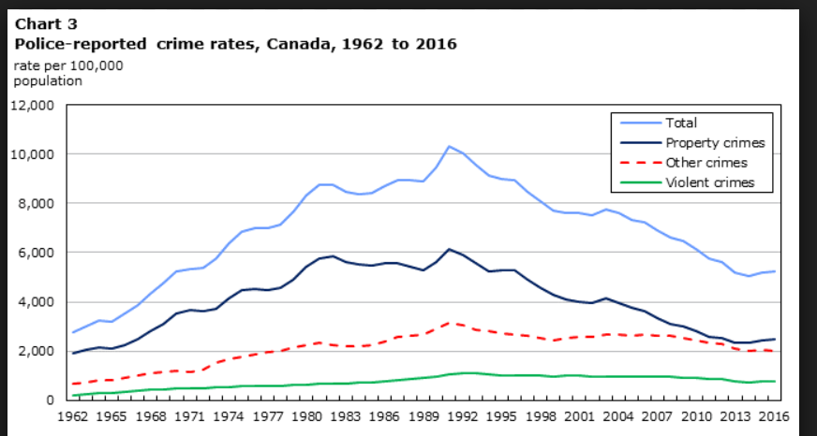
Why it is important?
Social and government agencies struggle to control crimes.
Lots of manual work involved to do prescriptive analysis
Lack of management of historical data
Starting from individual to community, all get affected to some extent
Lack of trust and insecurity grows between individuals and groups

Slide 3
Dataset
Kaggle: Historical crime data of Chicago (2001-2017)
Volume: 6M
Attributes: 23 feature attributes
Example attributes: Case Number, Date, primary type, location descriptions, community area etc.

Slide 4

Proposed solution
Using machine learning in IBM Watson studio and apply neural network model to predict crimes for different location spaces (Residents, Open and closed spaces) for any given timeline (Hour, day of week and month, Business hours) and given community area.
Deployed solution as web service with endpoint allows to use this from any applications on the fly.

Slide 5
Crime prediction for location spaces using machine learning
Technical presentation

Slide 6


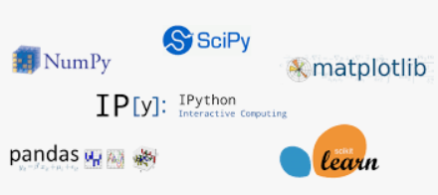

Architectural choices
Development environment
Deployment
Exploratory analysis
Model Framework

Slide 7
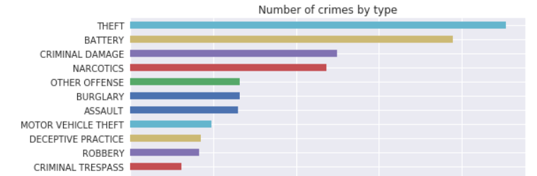
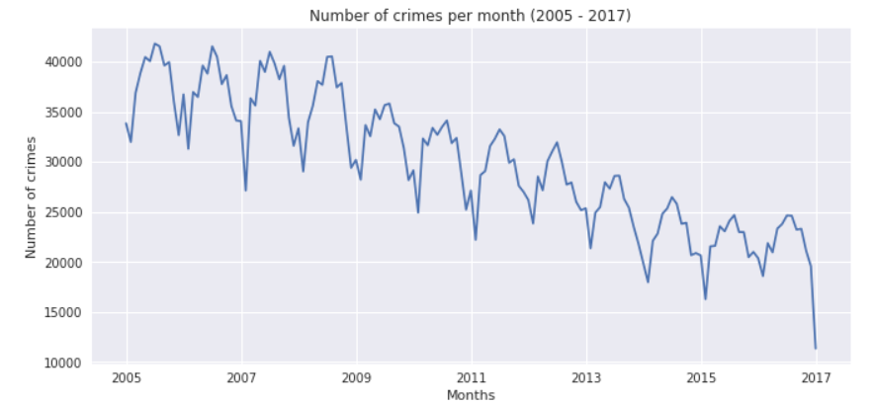
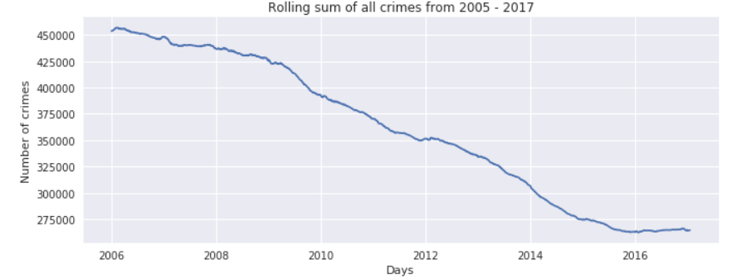
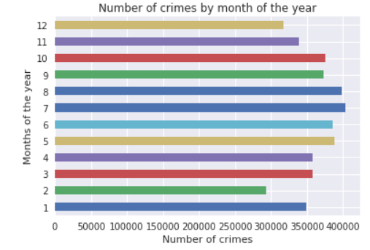
Data exploratory analysis
Minimal amount of missing data
Some columns need transformation
Crime in Chicago has steadily decreased year over year until 2015
We consistently see upticks in crime during the summer (seasonality)
More crimes occur in the latter half of the week than in the beginning
Some crime picks up in the morning early morning

Slide 8
Extract, Transform, Load
Historical data
Remove duplicate cases
Cleanup missing data
data format adjustments
Datetime indexing
Data cleansing
Select features set
Transform column values
Label time values
Encode target column
Model Input
Feature Engineering

Slide 9
Model Framework
Input
3 Hidden layers
(SGD,relu)
Output layer
(softmax)
Predicted class probabilities

Slide 10
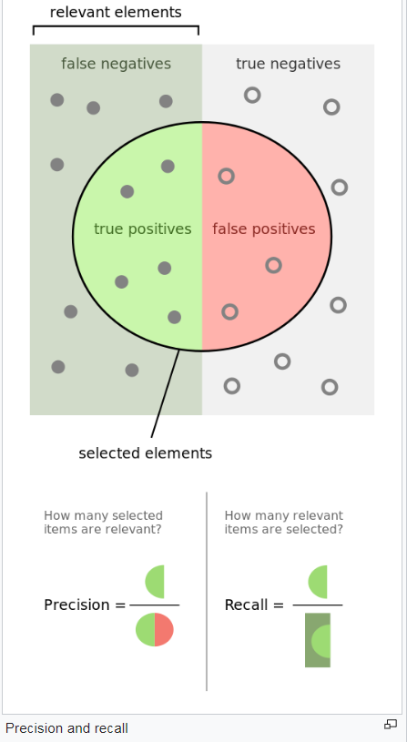
Model performance indicators
Metrics evaluated on predictions from test set
Model trained on 4 multilabel class categorical avg accuracy of 61%
Overall performance micro avg: F1 score 58%
Unbalanced classes leads to performance issues and overall less accuracy.

